Slide 1
Analysis findings how the data answers corporate questions

Slide 2

Overview

Slide 3

Reasons for Analysis
Answer business questions – both intra and inter department assistance
Discover potential cause & effect relationships that drive our metrics
Diagnose potential areas of inefficiency

Slide 4
General Topics
Unemployment
Effect of CPI on weekly sales
Holidays
The dataset

Slide 5
The Dataset
Source: Walmart Sales
VIA Mikhail1681 on Kaggle
https://www.kaggle.com/datasets/mikhail1681/walmart-sales/data
Walmart Sales is a dataset which records data about 45 different Walmart locations.
Data includes both retailer data & economic data
Key Variables
Store (location number, identifier)
Unemployment
Weekly Sales
CPI
Holiday Flag

Slide 6
Solutions via analysis
Answering business questions with statistical methods

Slide 7
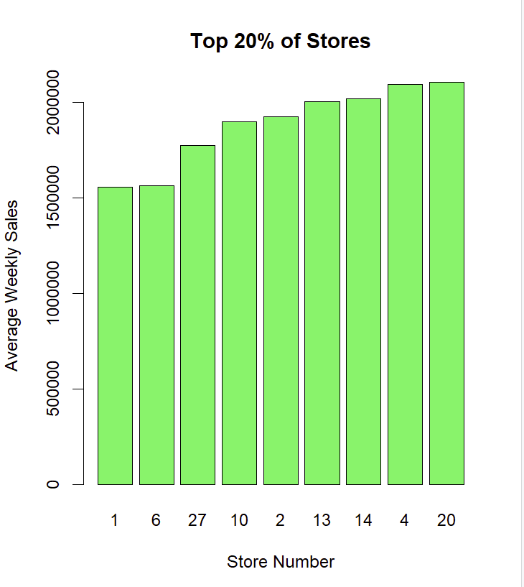

Which stores in the district have the lowest and highest average weekly sales?
Locations with the highest sales include 13, 14, 4, & 20, all having averages of more than $2,000,000/week

Slide 8
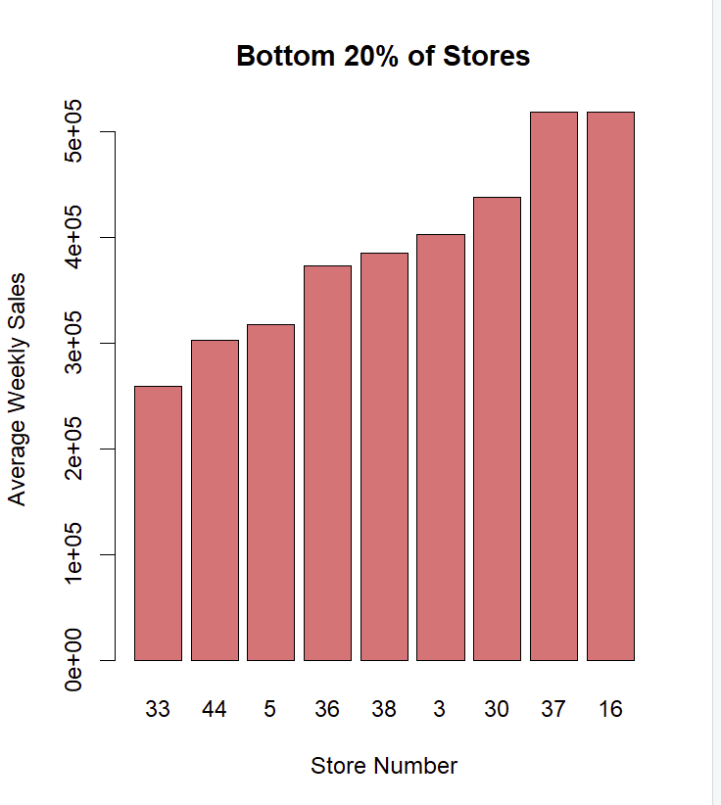
Which stores in the district have the lowest and highest average weekly sales?
Locations with the lowest sales include 33, 44, 5, & 36, all having averages of less than $400,000/week

Slide 9
The Model
We can predict weekly sales with the following model from our data.
Weekly Sales($) = 1664939.1 + 84509.6(If it's a holiday week) - 1652.8(CPI) - 42542.2(Unemployment Rate (%) * 100)

Slide 10
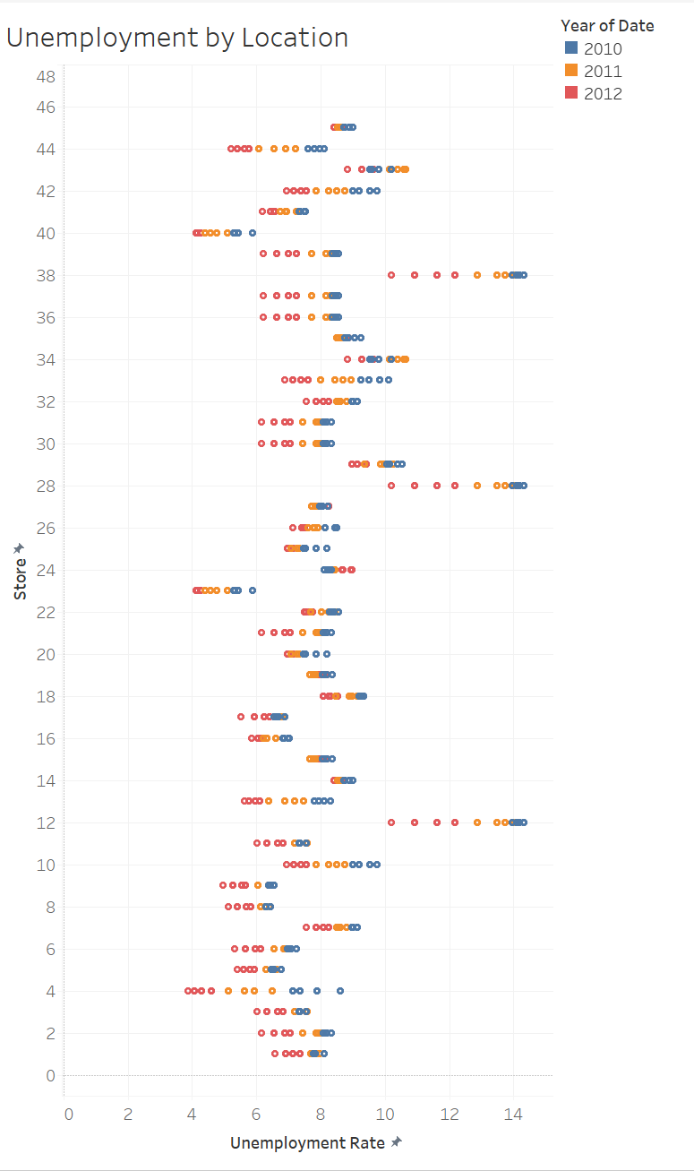
Which stores in the district have the lowest and highest unemployment rates?
Locations with the highest unemployment include 12, 28, & 38
Locations with the lowest unemployment include 4, 23, & 40

Slide 11
Big Red Flag – repeated observations
It appears that there are groups of stores reporting the same values for unemployment. This is likely due to these stores being in the same COUNTY, and the unemployment statistic collected is county unemployment. HOWEVER, as this is a public dataset that I did not have a hand in creating, I am unable to confirm this theory with the publisher, and this is simply an educated guess at the reasons behind the repetitions.

Slide 12
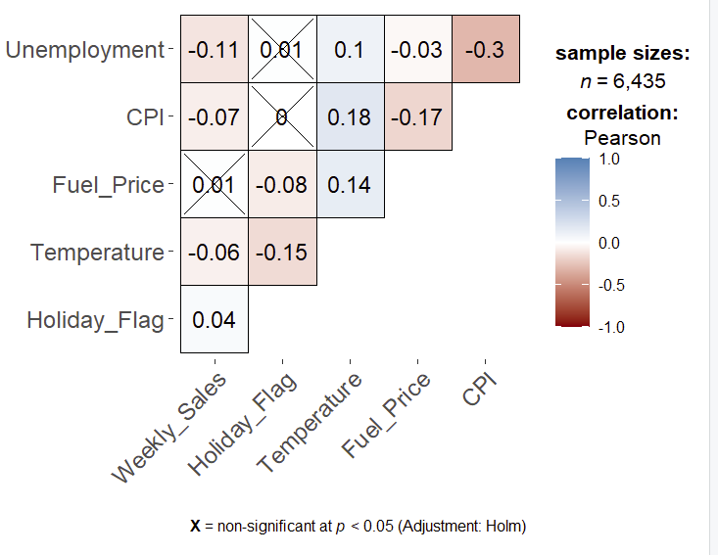
What factors do you think are impacting the unemployment rate?
Location
Unemployment varies drastically by store
We lack information about whether these stores are urban or not – lurking variable
CPI
Our data supports the generally accepted inverse relationship between inflation (inferred via CPI) and Unemployment
In our model, when CPI increases by 1 point, we predict a fall in Unemployment by 0.0144 points
Correlation matrix

Slide 13
Is there any correlation between CPI and Weekly Sales?
Negative
Very weak correlation
The intuition holds that a rise in prices would correlate with a fall in consumption

Slide 14
Do holidays impact the correlation between CPI and Weekly Sales?
Correlation is slightly weaker on holidays
It stands to reason that consumption around holidays may be slightly more inelastic
Potentially concerning small number of observations
Our sample of holiday observations is a bit small for inference to be conclusive
Holiday | Regular Day
-0.29962 | -0.3021949

Slide 15
Why is Fuel Price is included in this dataset?
Fuel price, while volatile in price, has relatively inelastic demand in the short term
The creator of the dataset likely believed it to be a useful *loose* benchmark of short term, localized CPI
The creator may also have used this dataset to examine relationships between localized fuel price and other variables in the dataset.

Slide 16
THANK YOU
Will Au
willau000@gmail.com
https://github.com/willau00

Slide 17
Special Thanks to
Mikhail1681 on Kaggle for the public dataset
Mary the Analyst on TikTok who inspired the project and suggested some interesting questions to include

